Slide 1
COMPUTER ARCHITECTURE CSE - 323
Lecture 1: History of Computer

Slide 2
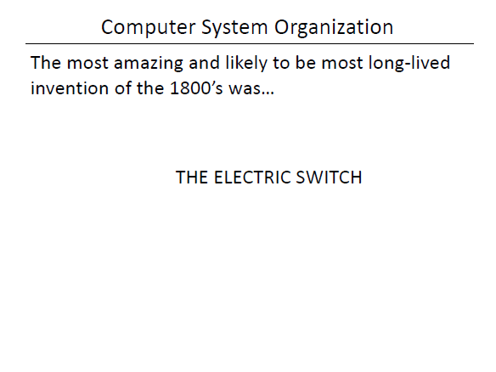
Electric Switch

Slide 3
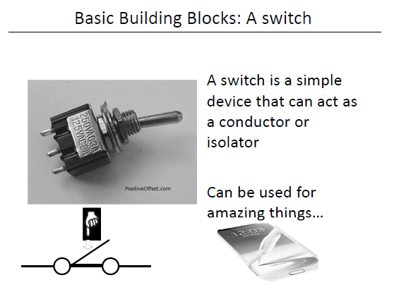
Electric Switch

Slide 4
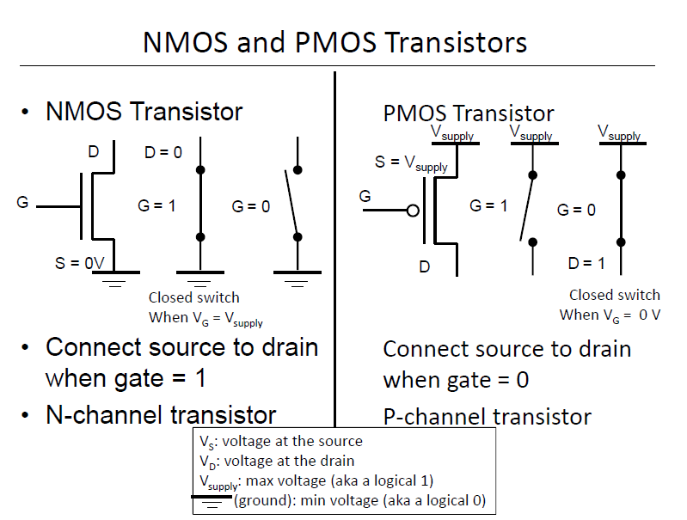
NMOS and PMOS

Slide 5
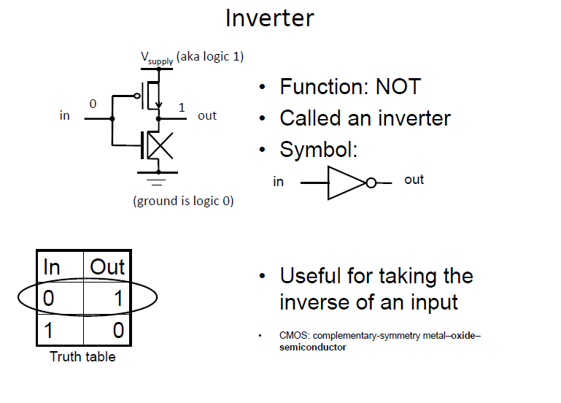
Inverter

Slide 6
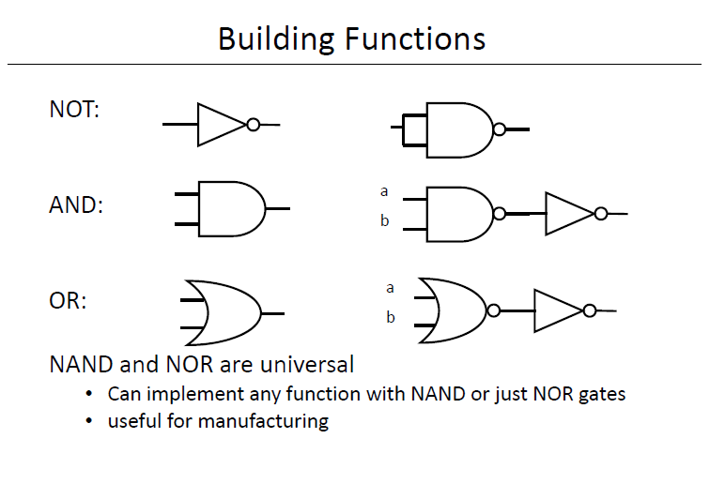
Building Functions

Slide 7
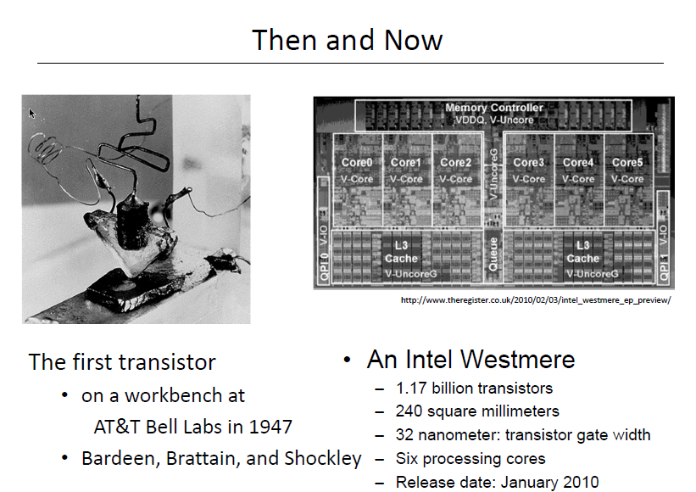
Then and Now

Slide 8
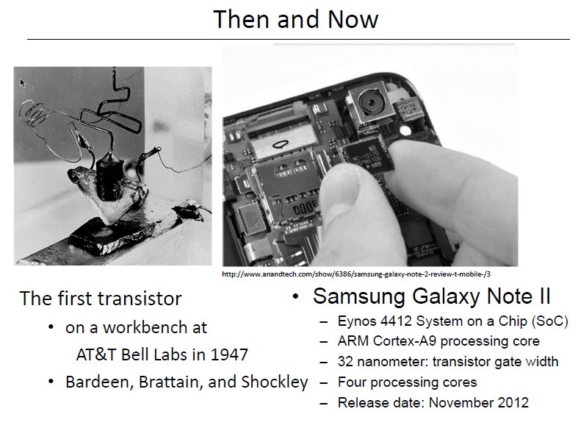
Then and Now

Slide 9
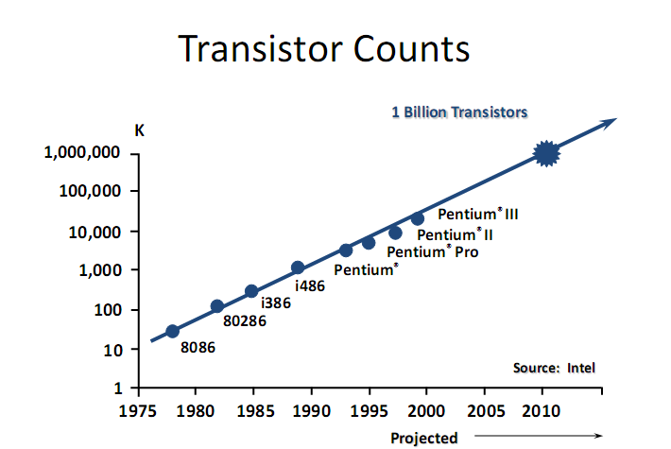
Transistor Counts

Slide 10
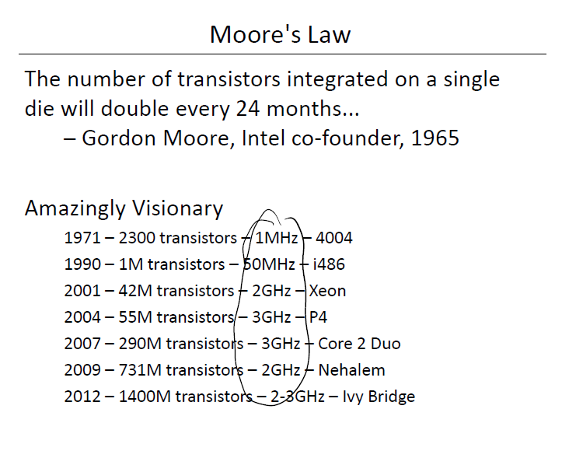
Moore’s Law

Slide 11
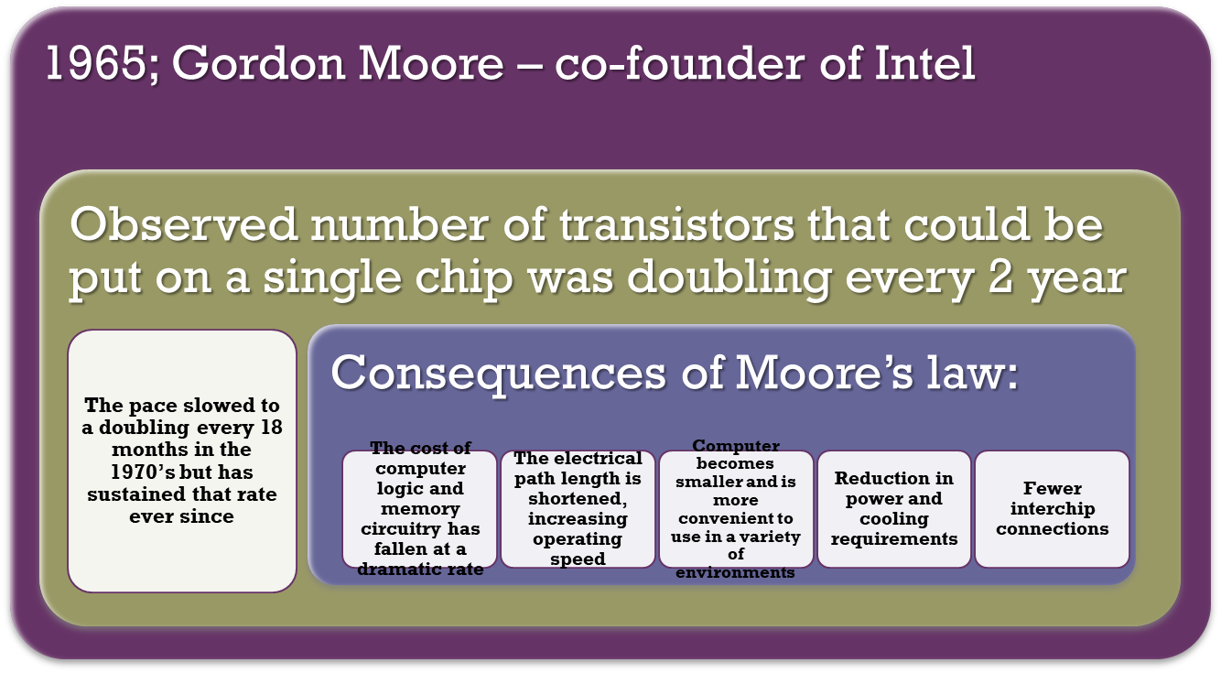
Moore’s Law

Slide 12
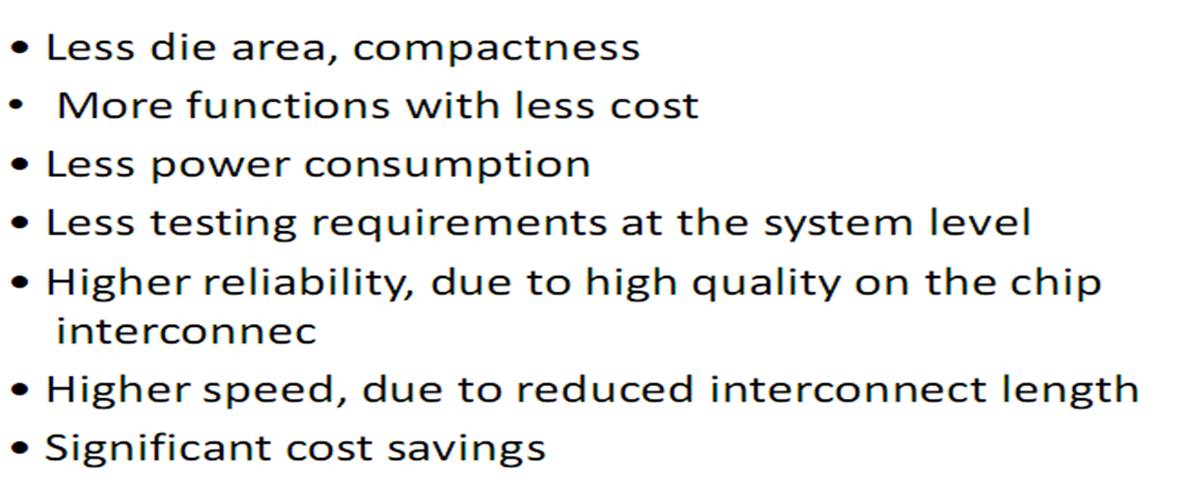
Why large scale integration?

Slide 13
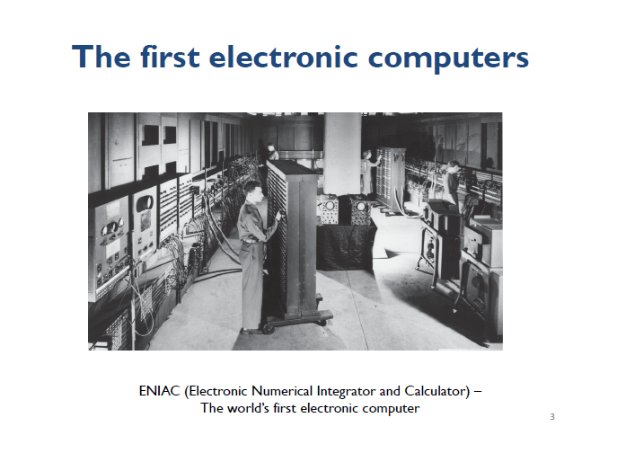
A bit of History

Slide 14
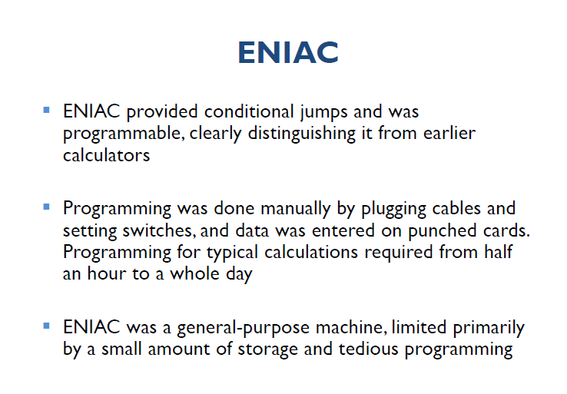
ENIAC

Slide 15
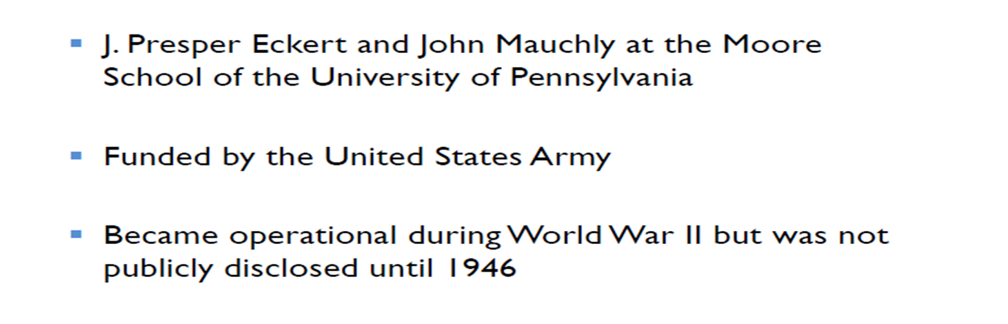
ENIAC

Slide 16
ENIAC
Weighed
30
tons
Occupied
1500
square
feet
of
floor
space
Contained
more
than
18,000
vacuum
tubes
140 kW
Power
consumption
Capable
of
5000
additions
per
second
Decimal
rather
than
binary
machine
Memory
consisted
of 20 accumulators,
each
capable
of
holding
a
10 digit
number
Major
drawback
was the need
for manual programming
by setting
switches
and
plugging/
unplugging
cables

Slide 17
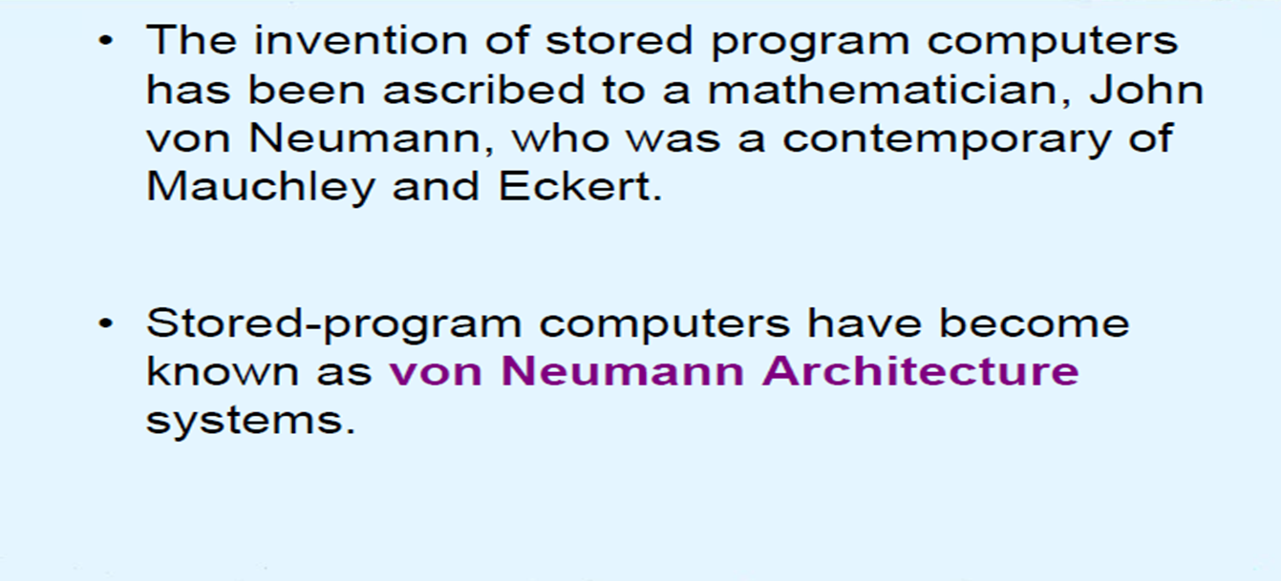
Von Neumann Model

Slide 18
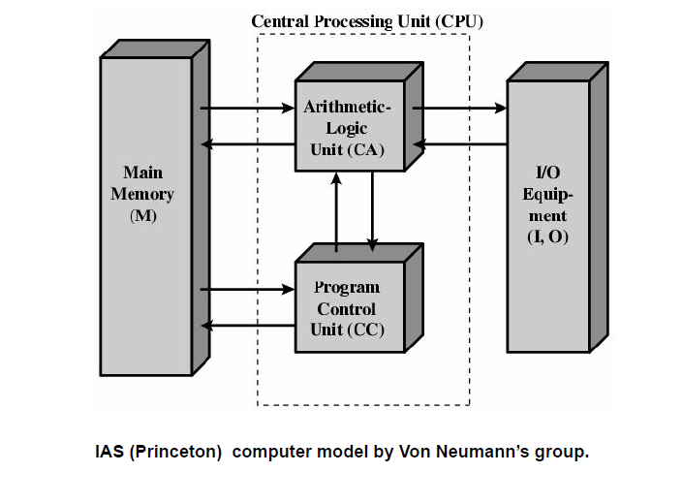
Von Neumann Model-IAS

Slide 19
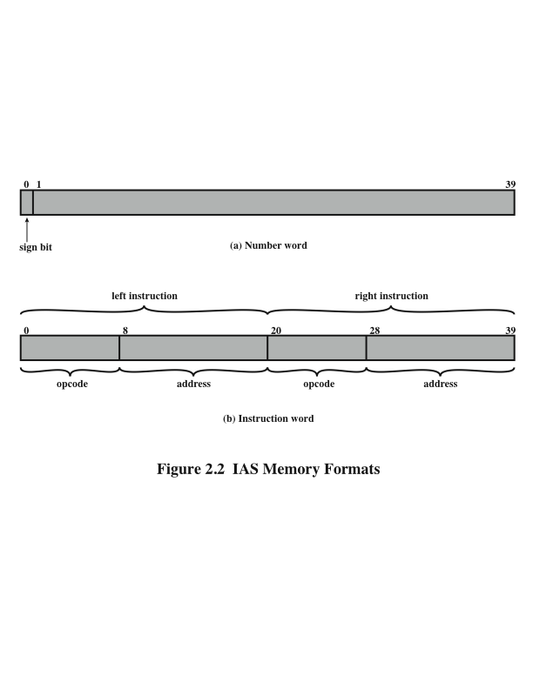
Memory Formats
Both data and instructions are stored there
Numbers are represented in binary form and each instruction is a binary code
The memory of the IAS consists of 1000 storage locations (called words) of 40 bits each

Slide 20
Registers
Memory buffer register (MBR)
Contains a word to be stored in memory or sent to the I/O unit
Or is used to receive a word from memory or from the I/O unit
Memory address register (MAR)
Specifies the address in memory of the word to be written from or read into the MBR
Instruction register (IR)
Contains the 8-bit opcode instruction being executed
Instruction buffer register (IBR)
Employed to temporarily hold the right-hand instruction from a word in memory
Program counter (PC)
Contains the address of the next instruction pair to be fetched from memory
Accumulator (AC) and multiplier quotient (MQ)
Employed to temporarily hold operands and results of ALU operations

Slide 21
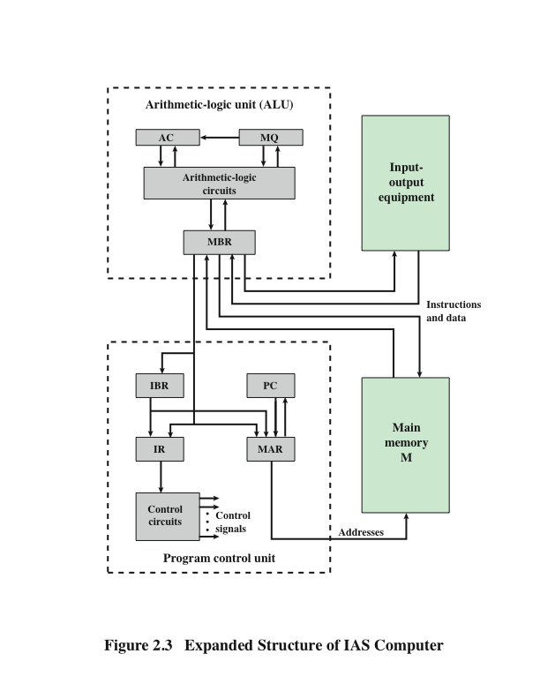
IAS
Structure of IAS Computer

Slide 22
Commercial Computers
1947 – Eckert and Mauchly formed the Eckert-Mauchly Computer Corporation to manufacture computers commercially
UNIVAC I (Universal Automatic Computer)
First successful commercial computer
Was intended for both scientific and commercial applications
Commissioned by the US Bureau of Census for 1950 calculations
The Eckert-Mauchly Computer Corporation became part of the UNIVAC division of the Sperry-Rand Corporation
UNIVAC II – delivered in the late 1950’s
Had greater memory capacity and higher performance
Backward compatible

Slide 23
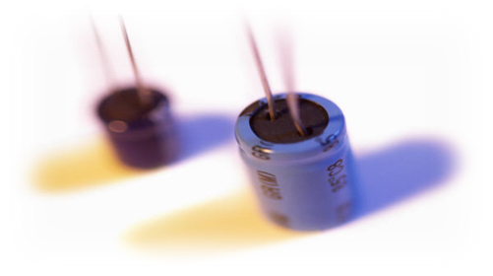
Second Generation Computer: Transistors
Smaller
Cheaper
Dissipates less heat than a vacuum tube
Is a solid state device made from silicon
Was invented at Bell Labs in 1947
It was not until the late 1950’s that fully transistorized computers were commercially available

Slide 24
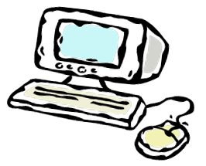
Second Generation Computers
Introduced:
More complex arithmetic and logic units and control units
The use of high-level programming languages
Provision of system software which provided the ability to:
load programs
move data to peripherals and libraries
perform common computations
Appearance of the Digital Equipment Corporation (DEC) in 1957
PDP-1 was DEC’s first computer
This began the mini-computer phenomenon that would become so prominent in the third generation

Slide 25
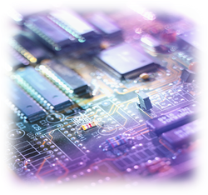
Third Generation computer: Integrated Circuits
1958 – the invention of the integrated circuit
Discrete component
Single, self-contained transistor
Manufactured separately, packaged in their own containers, and soldered or wired together onto masonite-like circuit boards
Manufacturing process was expensive and cumbersome
The two most important members of the third generation were the IBM System/360 and the DEC PDP-8

Slide 26
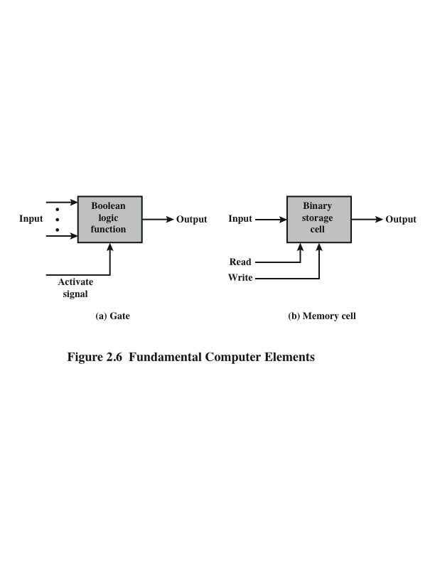
Microelectronics
Notes:
Gate:Gate is a device that implements a simple Boolean function.

Slide 27
Integrated Circuits
A computer consists of gates, memory cells, and interconnections among these elements
The gates and memory cells are constructed of simple digital electronic components
Four Basic Function:
Data storage – provided by memory cells
Data processing – provided by gates
Data movement – the paths among components are used to move data from memory to memory and from memory through gates to memory
Control – the paths among components can carry control signals

Slide 28
Integrated Circuits
Exploits the fact that such components as transistors, resistors, and conductors can be fabricated from a semiconductor such as silicon
Many transistors can be produced at the same time on a single wafer of silicon
Transistors can be connected with a processor metallization to form circuits

Slide 29
Beyond the third generation
Later
Generations
LSI
Large
Scale Integration
VLSI
Very Large Scale Integration
ULSI
Ultra Large
Scale
Integration
Semiconductor Memory Microprocessors

Slide 30
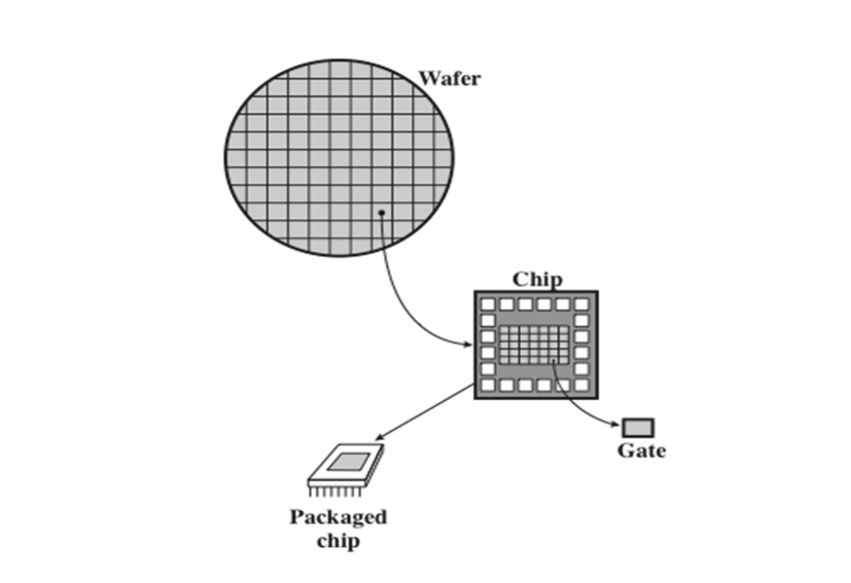
Key Concepts in an Integrated Circuit
Wafer, Chip, and Gate Relationship
Notes:
In electronics, a wafer (also called a slice or substrate) is a thin slice of semiconductor, such as a crystalline silicon (c-Si), used for the fabrication of integrated circuits and, in photovoltaics, to manufacture solar cells. The wafer serves as the substrate for microelectronic devices built in and upon the wafer. It undergoes many microfabrication processes, such as doping, ion implantation, etching, thin-film deposition of various materials, and photolithographic patterning.
Wafer is broken up into chips.Each chip is consists of many gates and memory cells and a number of input output attactments.

Slide 31
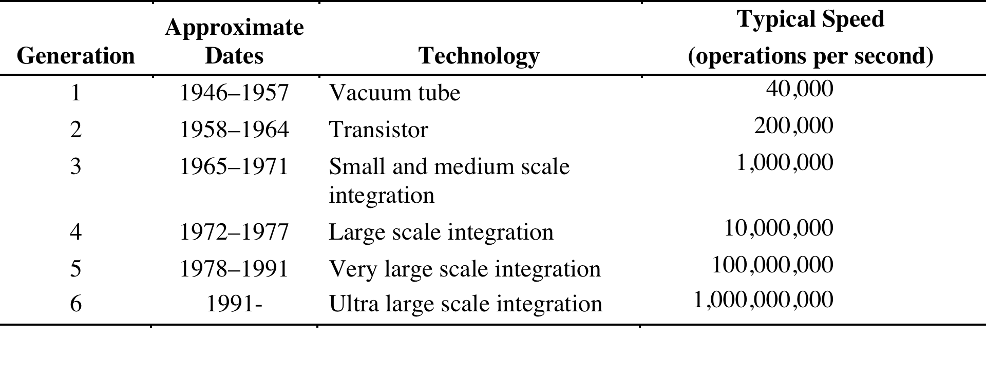
Computer Generations

Slide 32
CA vs. CO
Computer Architecture vs. Computer Organization

Slide 33
CA vs.CO(CT1)
Attributes of a system visible to the programmer
Have a direct impact on the logical execution of a program
Instruction set, number of bits used to represent various data types, I/O mechanisms, techniques for addressing memory
Computer Architecture
Architectural attributes include:
Organizational attributes include:
Computer Organization
Hardware details transparent to the programmer such as control signals, interfaces between the computer and peripherals, memory technology used
The operational units and their interconnections that realize the architectural specifications

Slide 34
COMPUTER ARCHITECTURE
Basic Components

Slide 35
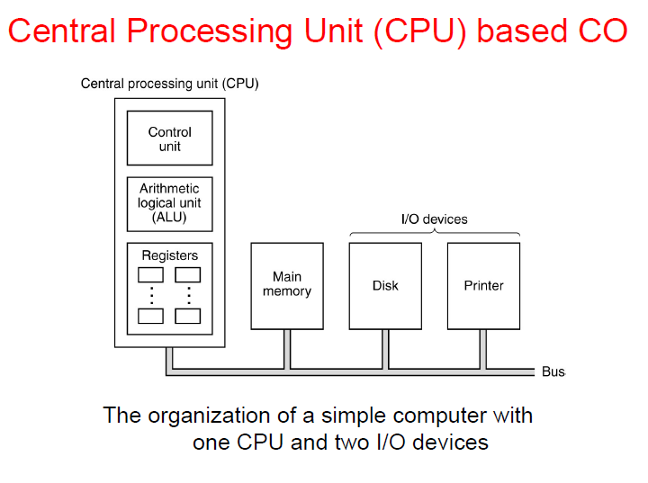
Computer Organization (CO)

Slide 36
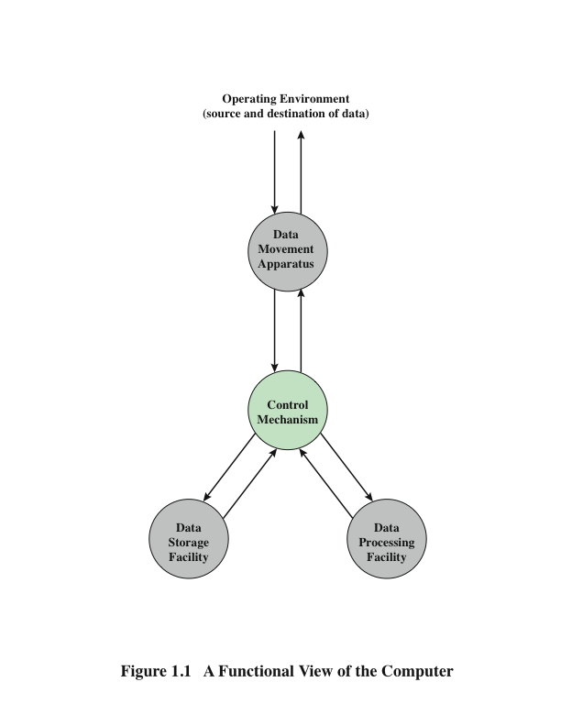
Functions
A computer can perform four basic functions:
a. Data movement
b. Data storage
c. Data processing
d. Control

Slide 37
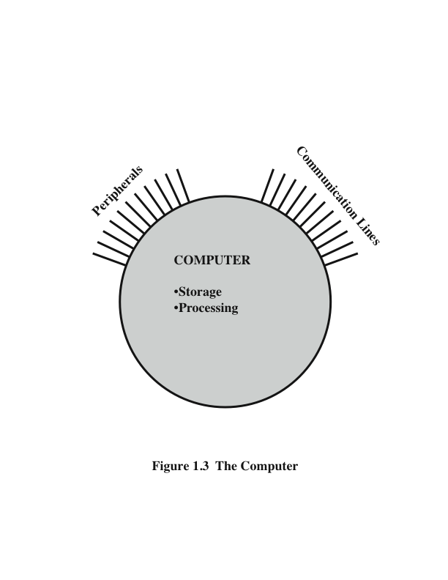
The simplest possible depiction of a computer
This works viewed by us
We mainly see two types of function in computer :storage
and processing. For data processing it has
control unit.By controlling instructions it processes data.
These storage and processing connect with different
peripheral device(mouse ,keyboard).The peripherals
connect through communication lines(BUS)

Slide 38
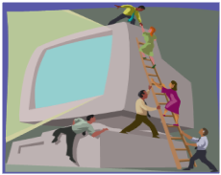
Structure and Function
Structure
The way in which components relate to each other
Function
The operation of individual components as part of the structure

Slide 39
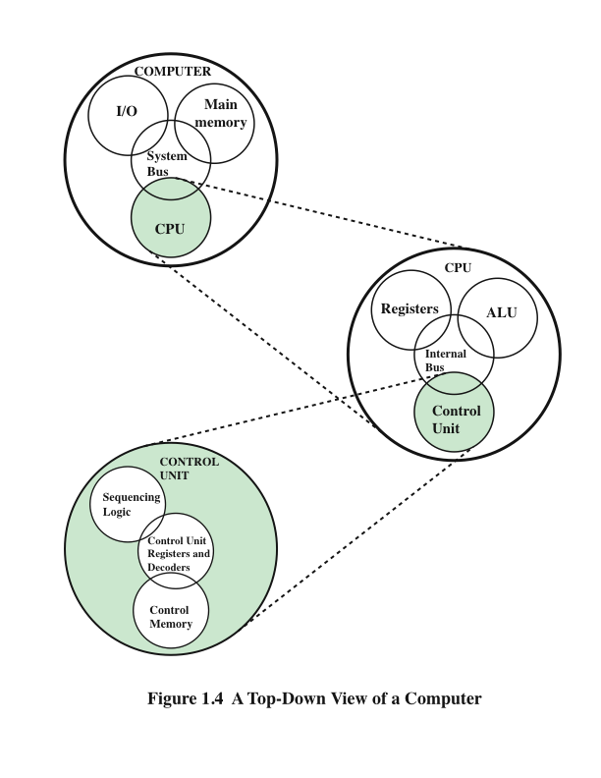
Structure(ON Copy)

Slide 40
Structure
CPU – controls the operation of the computer and performs its data processing functions
Main Memory – stores data
I/O – moves data between the computer and its external environment
System Interconnection – some mechanism that provides for communication among CPU, main memory, and I/O
There are four main structural components
of the computer:

Slide 41
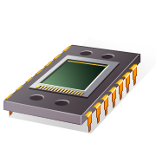
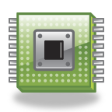
CPU
- Control Unit
Controls the operation of the CPU and hence the computer
Arithmetic and Logic Unit (ALU)
Performs the computer’s data processing function
Registers
Provide storage internal to the CPU
CPU Interconnection
Some mechanism that provides for communication among the control unit, ALU, and registers
Major structural components:

Slide 42
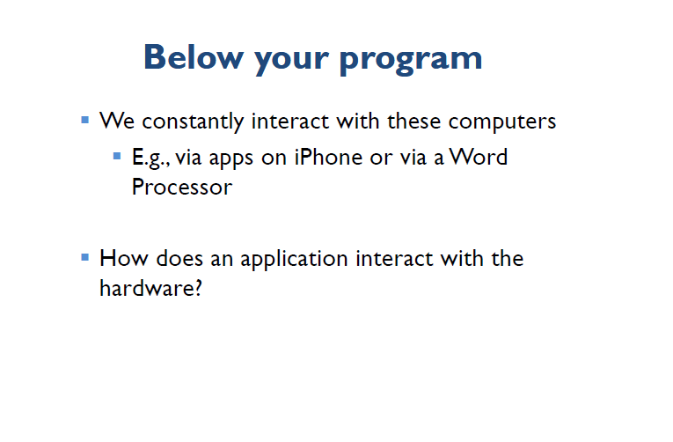
Below your program

Slide 43
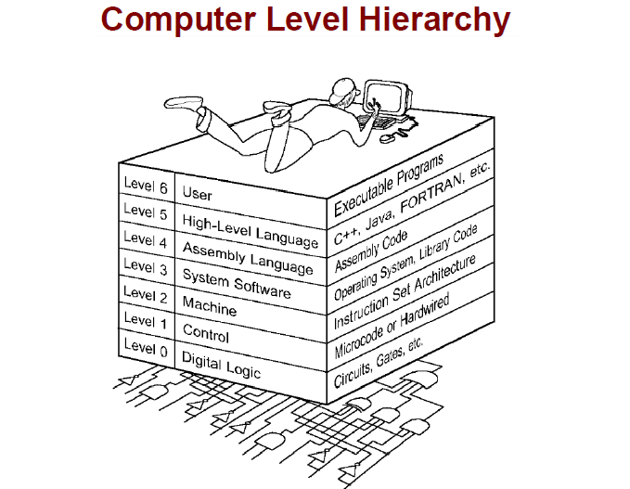
Computer Level Hierarchy
Notes:
Level 3: here library functions are included. By using those library function our program works

Slide 44
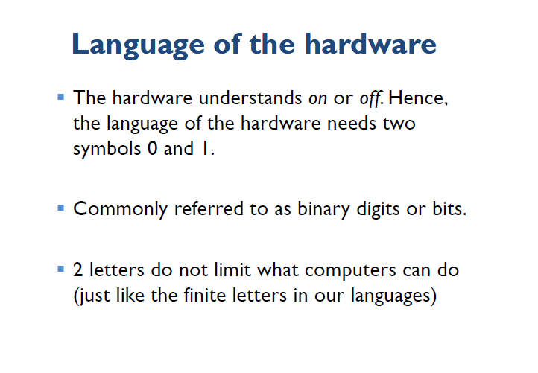
Language of the Hardware

Slide 45
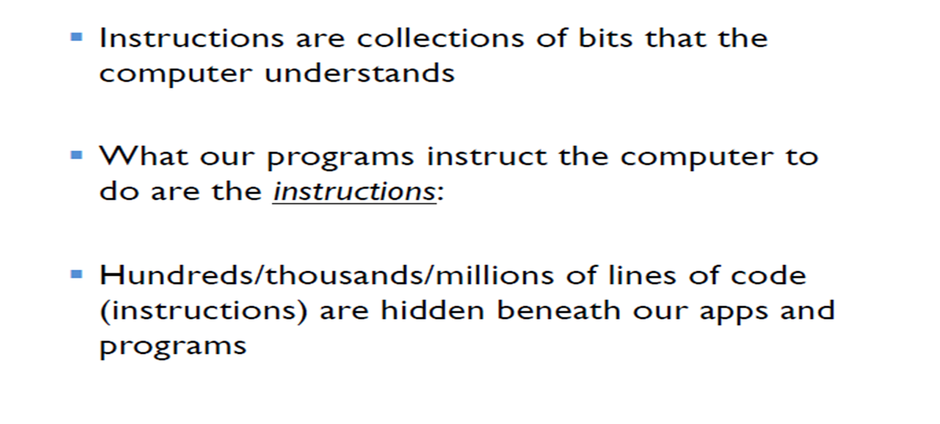
Language of the Hardware

Slide 46
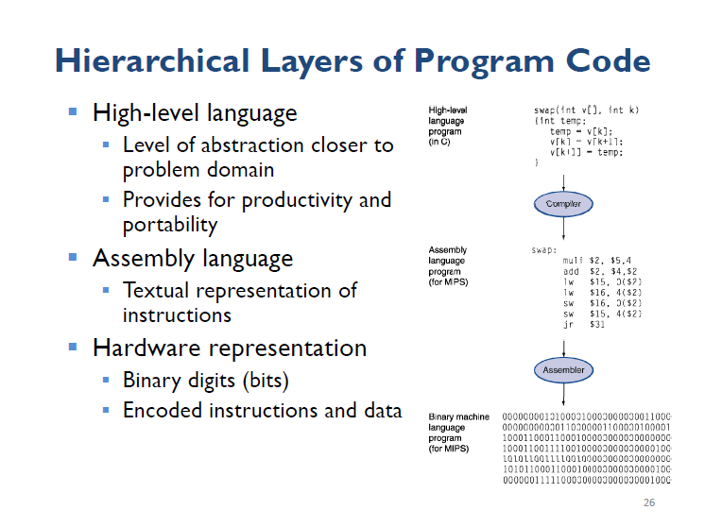
Hierarchical Layers of Program Code

Slide 47
COMPUTER ARCHITECTURE
More on Evolution

Slide 48
Semiconductor Memory
In 1970 Fairchild produced the first relatively capacious semiconductor memory
Chip was about the size of a single core
Could hold 256 bits of memory
Non-destructive
Much faster than core
In 1974 the price per bit of semiconductor memory dropped below the price per bit of core memory
There has been a continuing and rapid decline in memory cost accompanied by a corresponding increase in physical memory density
Developments in memory and processor technologies changed the nature of computers in less than a decade
Since 1970 semiconductor memory has been through 13 generations
Each generation has provided four times the storage density of the previous generation, accompanied by declining cost per bit and declining access time
Notes:
The first application of integrated circuit technology
to computers was construction of the processor (the control unit and the arithmetic
and logic unit) out of integrated circuit chips. But it was also found that this same
technology could be used to construct memories.
In the 1950s and 1960s, most computer memory was constructed from tiny
rings of ferromagnetic material, each about a sixteenth of an inch in diameter. These
rings were strung up on grids of fine wires suspended on small screens inside the
computer. Magnetized one way, a ring (called a core) represented a one; magnetized
the other way, it stood for a zero. Magnetic-core memory was rather fast; it took as
little as a millionth of a second to read a bit stored in memory. But it was expensive,
bulky, and used destructive readout: The simple act of reading a core erased the data
stored in it. It was therefore necessary to install circuits to restore the data as soon
as it had been extracted.

Slide 49
Microprocessors
The density of elements on processor chips continued to rise
More and more elements were placed on each chip so that fewer and fewer chips were needed to construct a single computer processor
1971 Intel developed 4004
First chip to contain all of the components of a CPU on a single chip
Birth of microprocessor
1972 Intel developed 8008
First 8-bit microprocessor
1974 Intel developed 8080
First general purpose microprocessor
Faster, has a richer instruction set, has a large addressing capability

Slide 50
Evolution of Intel Microprocessors
80’s processor
Notes:
In 80’s processor there is virtual memory.We convert virtual address to physical address

Slide 51
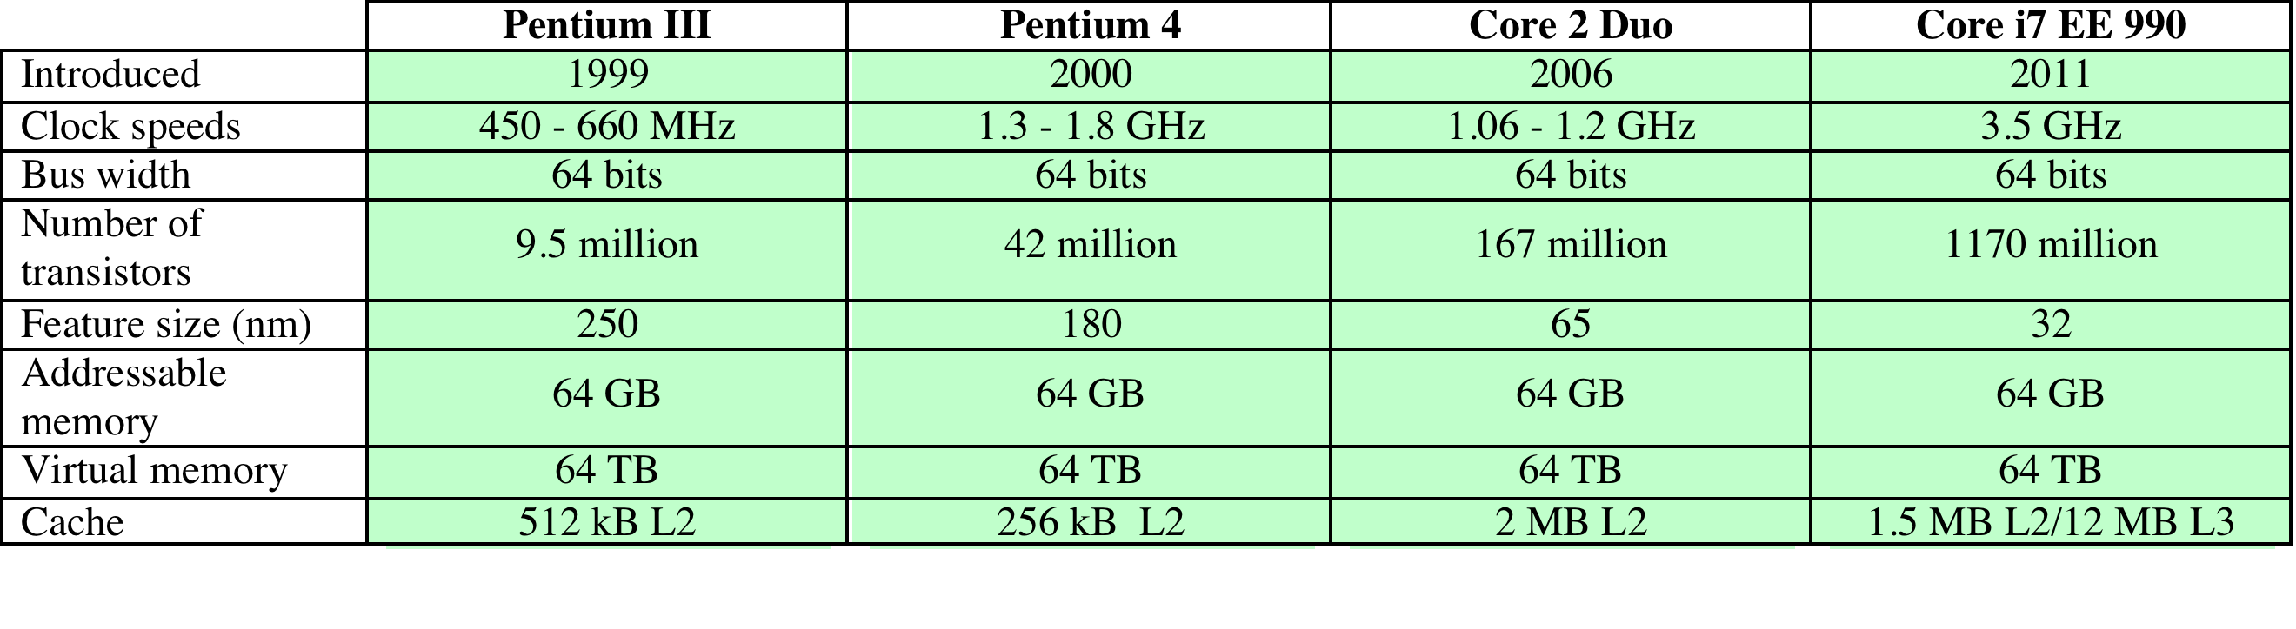
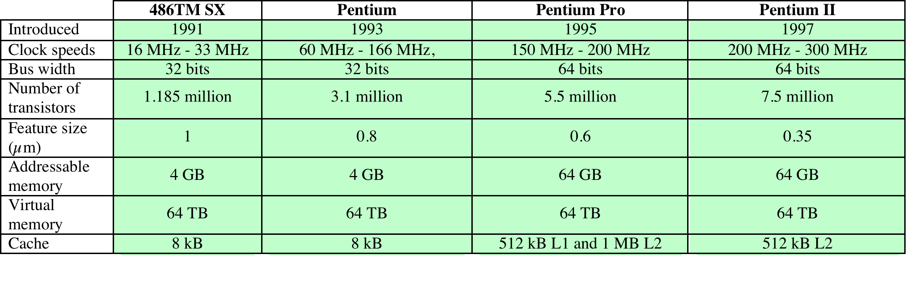
Evolution of Intel Microprocessors
90’s processor
Notes:
In 90’s there is cache memory.Cache is one kind of RAM.It is a static memory.It is very close to main memory

Slide 52
Microprocessor Speed
Techniques built into contemporary processors include:
Pipelining
Processor moves data or instructions into a conceptual pipe with all stages of the pipe processing simultaneously
Branch prediction
Processor looks ahead in the instruction code fetched from memory and predicts which branches, or groups of instructions, are likely to be processed next
Data flow analysis
Processor analyzes which instructions are dependent on each other’s results, or data, to create an optimized schedule of instructions
Speculative execution
Using branch prediction and data flow analysis, some processors speculatively execute instructions ahead of their actual appearance in the program execution, holding the results in temporary locations, keeping execution engines as busy as possible

Slide 53
Performance Balance
Adjust the organization and
architecture to compensate
for the mismatch among the
capabilities of the various
components
Architectural examples
include:
Increase the number of bits that are retrieved at one time by making DRAMs “wider” rather than “deeper” and by using wide bus data paths
Change the DRAM interface to make it more efficient by including a cache or other buffering scheme on the DRAM chip
Reduce the frequency of memory access by incorporating increasingly complex and efficient cache structures between the processor and main memory
Increase the interconnect bandwidth between processors and memory by using higher speed buses and a hierarchy of buses to buffer and structure data flow
Technique to increase processor performance

Slide 54
Improvements in Chip
Increase hardware speed of processor
Fundamentally due to shrinking logic gate size
More gates, packed more tightly, increasing clock rate
Propagation time for signals reduced
Increase size and speed of caches
Dedicating part of processor chip
Cache access times drop significantly
Change processor organization and architecture
Increase effective speed of instruction execution
Parallelism

Slide 55
Problems with Clock Speed and Login Density
CT1->What are the architectural constraints to increasing the clock speed?
Power
Power density increases with density of logic and clock speed
Dissipating heat
RC delay
Speed at which electrons flow limited by resistance and capacitance of metal wires connecting them
Delay increases as RC product increases
Wire interconnects thinner, increasing resistance
Wires closer together, increasing capacitance
Memory latency
Memory speeds lag processor speeds

Slide 56
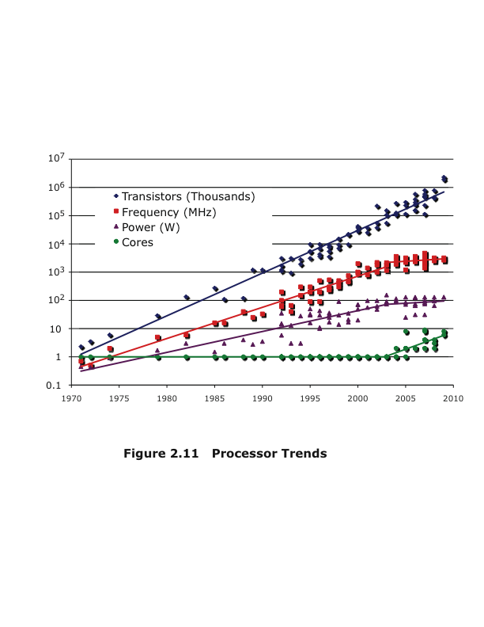
Processor Trends

Slide 57
Multicore
CT1->What other alternatives are available to improve performance of a computer?
Ans:slide57+58
The use of multiple processors on the same chip provides the potential to increase performance without increasing the clock rate
Strategy is to use two simpler processors on the chip rather than one more complex processor
With two processors larger caches are justified
As caches became larger it made performance sense to create two and then three levels of cache on a chip
Here each core has equal:
1.Size
2.Capacity
3.Resistor number
4.Working frequency

Slide 58
Many Integrated Core vs. Graphics Processing Unit
Many Integrated Core
Graphics Processing Unit
Leap in performance as well as the challenges in developing software to exploit such a large number of cores
The multicore and MIC strategy involves a homogeneous collection of general purpose processors on a single chip
Core designed to perform parallel operations on graphics data
Traditionally found on a plug-in graphics card, it is used to encode and render 2D and 3D graphics as well as process video
Used as vector processors for a variety of applications that require repetitive computations
Notes:
Chip manufacturers are now in the process of making a huge leap forward
in the number of cores per chip, with more than 50 cores per chip. The leap in
performance as well as the challenges in developing software to exploit such a large
number of cores have led to the introduction of a new term: many integrated core
(MIC).
The multicore and MIC strategy involves a homogeneous collection of
general-purpose processors on a single chip. At the same time, chip manufacturers
are pursuing another design option: a chip with multiple general-purpose processors
plus graphics processing units (GPUs) and specialized cores for video processing
and other tasks. In broad terms, a GPU is a core designed to perform parallel
operations on graphics data. Traditionally found on a plug-in graphics card (display
adapter), it is used to encode and render 2D and 3D graphics as well as process
video.
Since GPUs perform parallel operations on multiple sets of data, they are
increasingly being used as vector processors for a variety of applications that
require repetitive computations. This blurs the line between the GPU and the
CPU [FATA08, PROP11]. When a broad range of applications are supported
by such a processor, the term general-purpose computing on GPUs (GPGPU)
is used.

Slide 59

Embedded Systems
A combination of computer hardware and software, and perhaps additional mechanical or other parts, designed to perform a dedicated function. In many cases, embedded systems are part of a larger system or product, as in the case of an antilock braking system in a car.

Slide 60
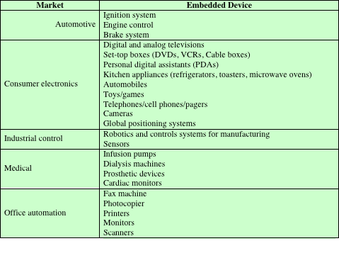
Examples of Embedded Systems

Slide 61
Requirements and Constraints
Small to large systems, implying different cost constraints and different needs for optimization and reuse
Relaxed to very strict requirements and combinations of different quality requirements with respect to safety, reliability, real-time and flexibility
Short to long life times
Different environmental conditions in terms of radiation, vibrations, and humidity
Different application characteristics resulting in static versus dynamic loads, slow to fast speed, compute versus interface intensive tasks, and/or combinations thereof
Different models of computation ranging from discrete event systems to hybrid systems

Slide 62
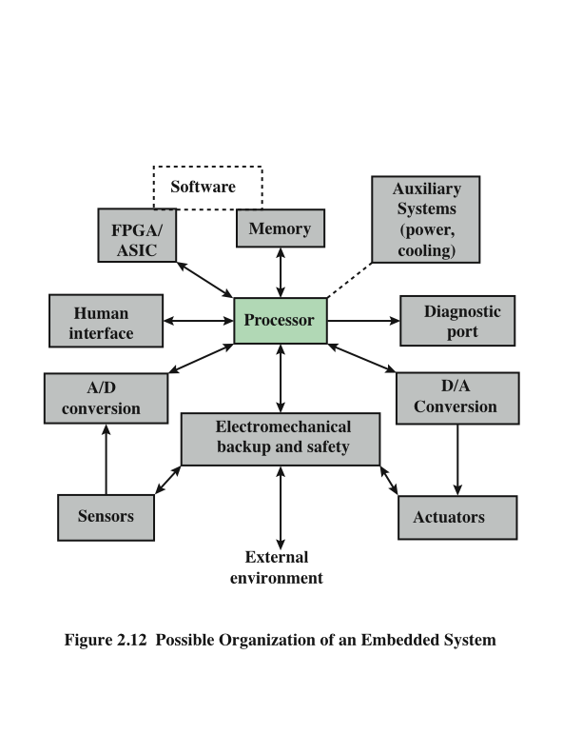
Possible Organization of an Embedded System

